Slide 1
What Is CVE & Vulnerability Database ?
What is CVE ?
CVE is a list of information security vulnerabilities and exposures that aims to provide common names for publicly known cyber security issues. The goal of CVE is to make it easier to share data…

Slide 2
What Is CVE & Vulnerability Database ?
What is CVE ?
…across separate vulnerability capabilities (tools, repositories, and services) with this "common enumeration."
https://cve.mitre.org/about/faqs.html#cve_identifier_descriptions_created

Slide 3
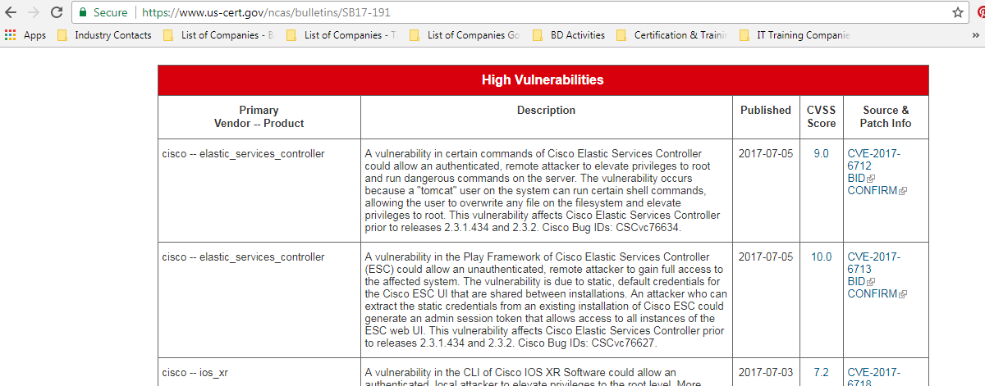
What Is CVE & Vulnerability Database ?
SNAPSHOT OF US-CERT VULNERABILITY BULLETINS

Slide 4
What Is CVE & Vulnerability Database ?
What is NVD ?
The NVD is the CVE dictionary augmented with additional analysis, a database, and a fine-grained search engine. The NVD is a superset of CVE. The NVD is synchronized with CVE such that any updates to CVE appear immediately on the NVD.
https://nvd.nist.gov/general/faq

Slide 5
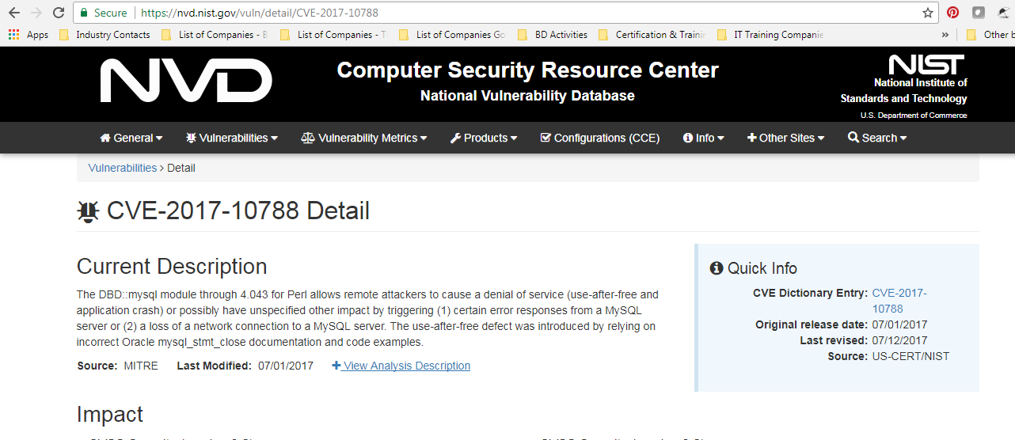
What Is CVE & Vulnerability Database ?
SNAPSHOT OF NATIONAL VULNERABILITY DATABASE - NVD

Slide 6
What Is CVE & Vulnerability Database ?
What is the NVD severity score ?
The NVD uses the Common Vulnerability Scoring System (CVSS) Version 2, which is is an open standard for assigning vulnerability impacts that is used by a variety of organizations
https://nvd.nist.gov/general/faq

Slide 7
What Is CVE & Vulnerability Database ?
What is the NVD severity score ?
NISTIR 7946 - CVSS Implementation Guidance describes methodologies developed by the NVD for using CVSS, and along with Appendix B describes the NVD’s entire vulnerability assessment process.
https://nvd.nist.gov/general/faq

Slide 8
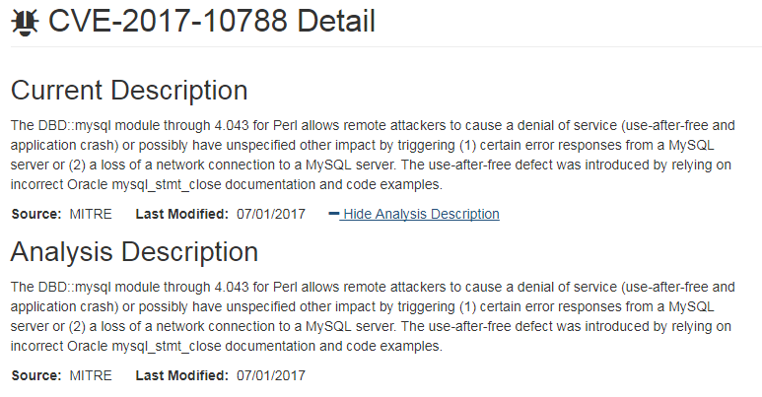
What Is CVE & Vulnerability Database ?
SNAPSHOT OF CVE-2017-10788
https://nvd.nist.gov/vuln/detail/CVE-2017-10788#vulnDescriptionTitle

Slide 9
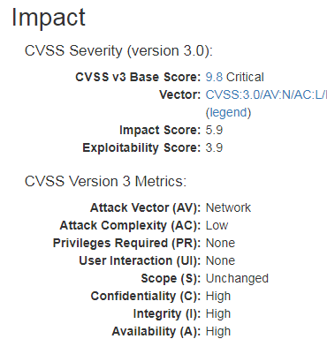
What Is CVE & Vulnerability Database ?
https://nvd.nist.gov/vuln/detail/CVE-2017-10788#vulnDescriptionTitle

Slide 10
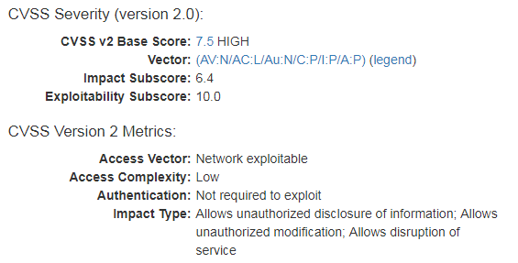
What Is CVE & Vulnerability Database ?
https://nvd.nist.gov/vuln/detail/CVE-2017-10788#vulnDescriptionTitle

Slide 11
What Is CVE & Vulnerability Database ?
Note that all the major vendors publish their security vulnerabilities online
Microsoft
Oracle
Cisco
Etc
END

